Slide 1

Shop Safety
Mater Dei Robotics

Slide 2
Agenda
Mater Dei Robotics
Do’s and Don’ts
Hand and Power Tool Safety
Drill Press Safety
Chop Saw Safety

Slide 3
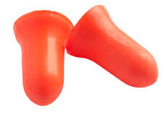

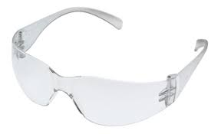

Do’s and Don’ts
Do
Use appropriate Personal Protective Equipment (PPE)
Safety Goggles
Ear Plugs or Hearing Protection Earmuffs
Practice Situational Awareness
Clean-Up After Yourself
Don’t
Horseplay
Wear Loose Clothing
Drill or Cut Through Work Tables

Slide 4
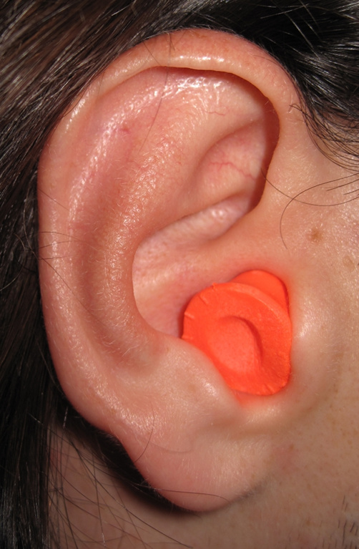
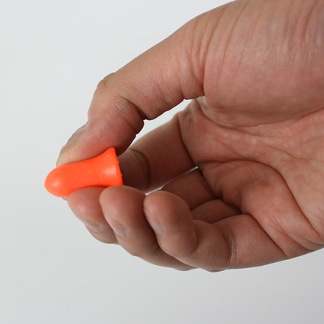

Hearing Protection
Roll ear plug between fingers and insert in to ear

Slide 5
Hand Tool Safety
Use the right tool for the job. Don't use your wrench as a hammer. Don't use a screwdriver as a chisel, etc. Go back to the tool house and get the right tool in the right size for the job.
Don't use broken or damaged tools, dull cutting tools, or screwdrivers with worn tips.
Cut in a direction away from your body.
Make sure your grip and footing are secure when using tools.
Pass a tool to another person by the handle; never toss it to them.

Slide 6
Hand Tool Safety, cont…
Never carry sharp or pointed tools such as a screwdriver in your pocket.
Store tools properly when you stop work.

Slide 7
Power Tool Safety
Gloves, loose clothing, jewelry or any dangling objects should not be worn as they may catch in the rotating parts of the tool.
Long hair should be tied back.
Wear safety glasses and hearing protection.
Clamp all work pieces to work table or equipment platform.
Make sure body parts (yours and your neighbors!) are out of tool path before turning on power.
Make all adjustments with the power shut off.

Slide 8
Drill Press Safety
Center punch the drill-hole location into the material.
Do not exceed the recommended speeds for the type and size of drill bit being used or composition of the stock being drilled.
Insert bit into drill chuck and tighten with the chuck key. Remove chuck key from the drill chuck before starting the drill press.
Use a clamp or vise to secure material to drill press table. NEVER HOLD BY HAND!
Keep hands and fingers away from rotating parts.
Do not attempt to stop drill by hand.

Slide 9
Chop Saw Safety
Full face shield and safety glasses are required. Operators should always wear safety glasses under a full face shield.
All guards must be in place and operating. If a guard seems slow to return to its normal position or hangs up, notify instructor or mentor.
Hands and fingers must be kept clear of the path in which the blade travels.
Clean cutting debris from saw before using. Unplug before adjusting or cleaning.
Use only the recommended RPM and sizes of blades.
Regularly check and tighten the blade and the blade-attachment mechanism.

Slide 10
Chop Saw Safety, cont…
Prior to installing or changing a blade, be sure to lockout or unplug equipment. Ensure that the blade and its related washers and fasteners are correctly positioned and secured on the saw's arbor.

Slide 11

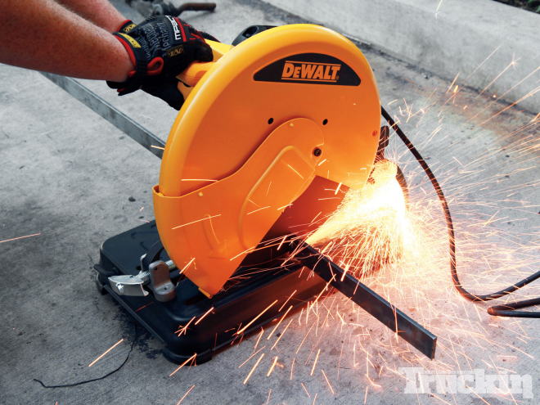
Chop Saw Safety, cont…
To avoid losing control or placing hands in the blade path, hold or clamp all material securely against the fence when cutting. Do not perform operations freehand.
Never re-cut small pieces. Long material should be supported at the same height as the saw table.
Never place hands or fingers in the path of the blade or reach in back of the fence.

Slide 12
Chop Saw Safety, cont…
Use the blade brake.
After completing a cut, release the trigger switch and allow the blade to come to a complete stop, then raise the blade from the work piece. If the blade stays in the cutting area after the cutting is complete, injury can result from accidental contact.
NEVER USE CHOP SAW WITH PERMISSION FROM INSTRUCTOR OR MENTOR.

